Slide 2
From medicine to positive health:
how can integrated community care contribute?
Jean Macq
Jean.macq@uclouvain.be
IRSS-UCLouvain

Slide 3
Key points
A dynamic and positive perspective of health and consequences on enhancing social cohesion through community strengthening
The future contribution of medicine to health: between the 4P’s and proximity providers as part of a social system ty integrated care as a way forward?
The 4P’s as mainstream because driving force to establish healthcare priorities is not (only) to improve health
Community integrated care and proximity providers: how? Place-based governance? Financing?

Slide 4
(Positive) health and social determinants:
What is largely accepted?

Slide 5
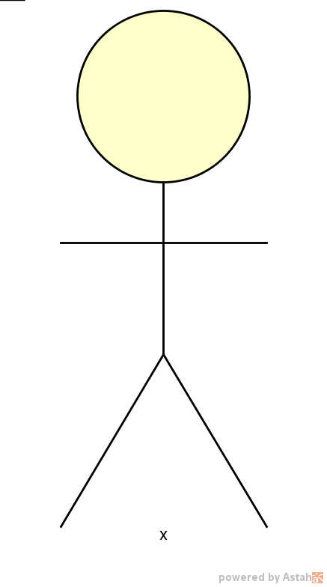
Positive approach of health – Key concepts?
Life course - dynamic
« ecological »
adaptation
health
Values
Culture
« sense-making »
Development
1 Huber, M ; Knottnerus J. How should we define ‘health’? Bmj 2010; 341: c4303–c4303.
2 Halfon N. Part 1: Context and Background The Emerging Theoretical Framework of Life Course Health Development. DOI:10.1007/978-3-319-47143-3_2.
3 Martin C, Sturmberg J. Complex adaptive chronic care. J Eval Clin Pract 2009; 15: 571–7.
4 Evans RG, Stoddart GL. Producing health, consuming health care. Soc Sci Med 1990; 31: 1347–63.

Slide 6
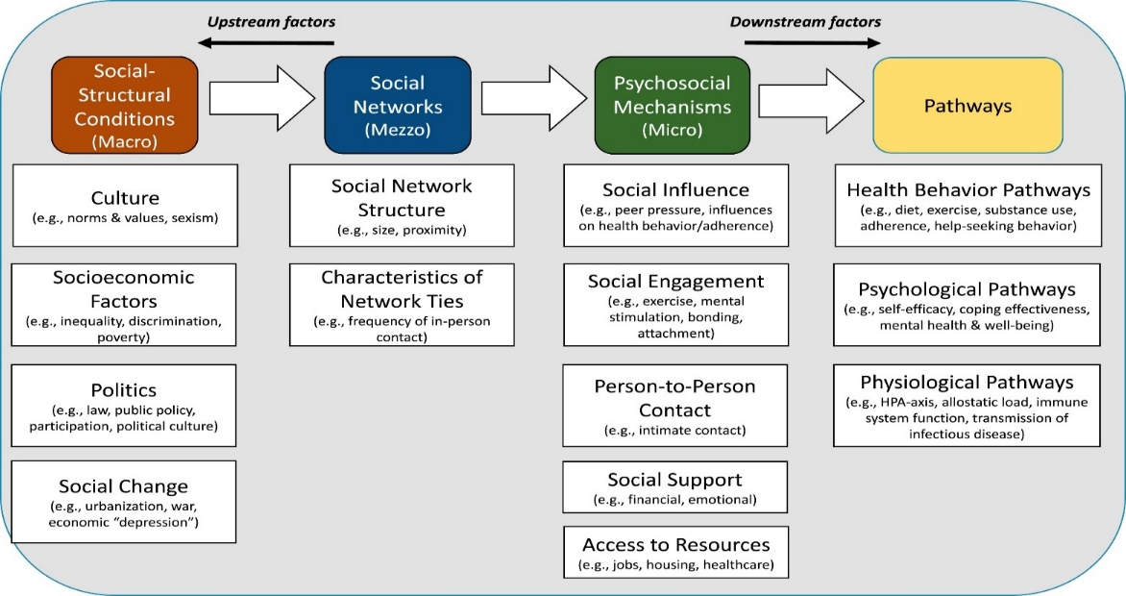
J. Macq – IRSS-UCL 2018
From person to people and community centred: social environmental multilevel interactions
From: Berkman LF, Glass T, Brissette I, Seeman TE. From social integration to health: Durkheim in the new millennium. Soc. Sci. Med. 2000;51:843–57.

Slide 7
J. Macq – IRSS-UCL 2018
From person to people and community centred: social environmental multilevel interactions
Disease, patient centred care
From: Berkman LF, Glass T, Brissette I, Seeman TE. From social integration to health: Durkheim in the new millennium. Soc. Sci. Med. 2000;51:843–57.

Slide 8
J. Macq – IRSS-UCL 2018
From person to people and community centred: social environmental multilevel interactions
People and community care
From: Berkman LF, Glass T, Brissette I, Seeman TE. From social integration to health: Durkheim in the new millennium. Soc. Sci. Med. 2000;51:843–57.

Slide 9
Consequences of developing people and community care
Time-frame
Not limited to the onset of a disease or a health problem
Lifelong and sometimes between generation
Content of the package:
Individual care and support
Curative and preventive services
Health promotion
« wellbeing » services (support to ADL and IADL)
Involvement of community:
Solidarity enhancement as a form of caring the people in need
Assets based care as a form of people empowerment

Slide 10
The future contribution of medicine to health: between the 4P’s and proximity providers as part of a social system ty integrated care as a way forward?
2 different forms of integration

Slide 11
J. Macq – IRSS-UCL 2018
The future of medicine: technologies to continuously adapt treatment to targets for individuals
hospital
The 4 P’s medicine
personalized,
predictive,
preventive,
participatory
Central role of biomarkers
Specialized team
Specific health problem
people
coaching
Primary care team

Slide 12
J. Macq – IRSS-UCL 2018
Integration approach
Higher risk
Medium risk
Lower risk
Integrated care unit
Integrated care unit
Integrated care unit

Slide 13
J. Macq – IRSS-UCL 2018
The future of medicine: proximity providers as part of a social system
The proximity providers
play a role of « boundary spanning » and « knowledge brokering »
Contribute to the best balance between people life goals and enhancing social cohesion within communities
« mental health » sector
« social » sector
Home care support
… community health insurance…
Generalist primary care team
Neighbourhood associations
Childhood care

Slide 14
The future of medicine: the package of care to be provided (example)
Primary care
Community volunteer
Social prescribing
Life expert
Meeting space
Sharing skills
Neighbourhood house
Time bank (accorderie)
Brice A, Connolly AM, Davies C, Henderson G, Johnstone P, Butterworth O, et al. Community-centred approaches for health and wellbeing. 2015 [cited 2018 May 10]; Available from: www.gov.uk/phe

Slide 15
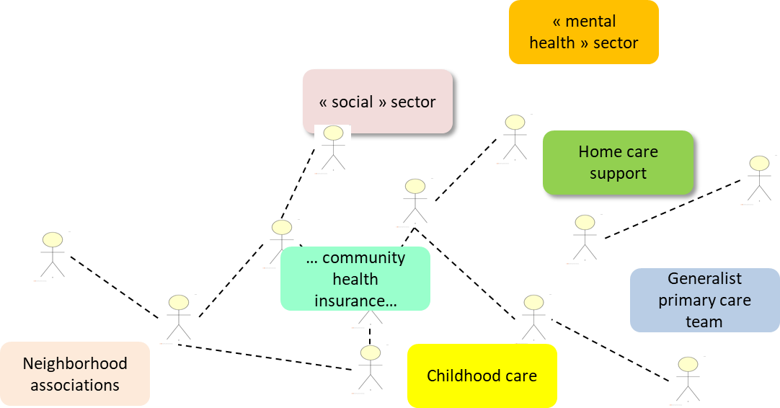
J. Macq – IRSS-UCL 2018
Integration approach
Specialized Integrated care unit
Integrated care unit
Integrated care unit
Specialized Integrated care unit
Integrated care unit

Slide 16
J. Macq – IRSS-UCL 2018
The mainstream driving force to establish healthcare priorities is not (only) to improve health
Health system organisation
Financial profit
Struggle between society segments
Struggle between professions
Perception of security
… health
Job

Slide 17
Integrated community care and proximity providers: how?
Place-based governance? Financing?

Slide 18
Place-base governance?
J. Macq – IRSS-UCL 2018
New public management
Centrally determined targets and metrics (objectively measurable)
Performance based payment (P4P or P4Q)
Often management per « silo » or organisations
Knowledge focused on « the » intervention to « copy » everywhere
« controlled » test of intervention at the centre of learning process
Place based governance
Local governance structure grouping stakeholders from different organisations for comprehensive solutions
Trust at the centre to manage uncertainty
General «frame » centrally defined
Local adaptation – learning by doing
« system thinking » at the centre of learning process
Inspired by Marsh I, Crowley K, Grube D, Eccleston R. Delivering Public Services: Locality, Learning and Reciprocity in Place Based Practice. Aust. J. Public Adm. 2017;76:443–56.

Slide 19
Key point for financing integrated community care
Need to including equity in health within the community and not only clinical quality improvement and cost reduction.
Looking at community mechanisms financing and / or resource in kind sharing (with the “good” effect of reciprocity). This give long term “return” by potentially decreasing cost of low-value or avoidable care…
To build-up that mechanisms, key principles of place-based governance prevails
Nichols LM, Taylor LA. Social Determinants As Public Goods: A New Approach To Financing Key Investments In Healthy Communities. Health Aff 2018; 37: 1223–30.

Slide 20
Challenges ahead
Choosing the right geographic scale is not obvious
This type of approach requires some degree of patience before “returns” or “benefits” are realized
This kind of upstream approach often require statutory changes, particularly to the scope of services that public payers can pay for.
Nichols LM, Taylor LA. Social Determinants As Public Goods: A New Approach To Financing Key Investments In Healthy Communities. Health Aff 2018; 37: 1223–30.

Slide 21
Key points
A dynamic and positive perspective of health and consequences on enhancing social cohesion through community strengthening
The future contribution of medicine to health: between the 4P’s and proximity providers as part of a social system ty integrated care as a way forward?
The 4P’s as mainstream because driving force to establish healthcare priorities is not (only) to improve health
Community integrated care and proximity providers: how? Place-based governance? Financing?

