Slide 1
The CoFoR Project (Recovery Training Centre) Marseille, France www.coforetablissement.fr
Context/history
What this initiative is about?
CoFoR is anchored on the Recovery College model. Recovery Colleges offer educational courses about mental health and recovery, designed to help students feel more confident in self-management of their own mental health and well-being. For persons with lived experience of mental ill health, taking control and become an expert in their own health and recovery is important to move on with their life.
People may use the college as an alternative to mental health services, alongside mental health services or to help them move out of mainstream mental health services.
Since 2009, the Recovery College has continued to expand around the world, with currently forty colleges including in England, Australia, Canada, Japan and the United States. CoFoR opened its doors in Marseille in September 2017. At the same time, an action research project was initiated with experience experts , peer workers, families and relatives, medico-social, social and psychiatric
professionals, researchers, artists, etc.
Target pop:
People in
Marseille and its
Region who
have or have had
mental health problems.
Mission:
To enable people who have had mental health issues to become experts in their own self-care and develop the skills and confidence to manage their own recovery journey.
Description:
The CoFoR is a Recovery Training Center, a unique place to experience new experiences and develop recovery-oriented practices. It is intended exclusively for people concerned by recovery, ie people having or having had mental disorders.
Recovery Colleges aim to support the well-being and recovery of people by promoting the development of knowledge and skills, the sharing of theoretical and experiential knowledge, support between peers and local roots.
Page 1

Slide 2
About / Aims
CoFoR is a RecoveryTraining Center for people who have or have had mental health problems. Seeking to move away from a clinical, hospital centric or even rehabilitation approach, the Recovery College focuses on using learning activity to complement traditional treatment approaches.
The approach:
Helps people recognise and make use of their talents and resources;
Assists people in exploring their possibilities and developing their skills; and
Supports people to achieve their goals and ambitions
The working principles of the model are founded on co-production and shared decision-making:
Non-therapeutic but educational approach
Partnership with different organizations
Co-construction of the project at all stages
Co-construction of training modules
Animation, facilitation of sessions in majority by users or ex-users of mental health, experience experts, peer workers.
Training location outside mental health organizations
Student status rather than user or patient
Free training & financial reward of 250€ for attendance
The Recovery College (model on which the CoFoR is anchored) cultivates training and co-construction.
CoFoR currently comprises 5 modules:
Recovery plan: Implementation of an Individualized Recovery Action Plan and Psychiatric Advance Directives. One afternoon a week for 11 weeks.
Wellness: Practice sport and techniques in the management of stress and anxiety: breathing, mindfulness, gentle fitness, “get back in touch with your body”, self-defense.
Rights: Know your rights vis-à-vis institutions. Learn to speak up.
Living with: Management of medication and substances, sexuality, living with your voice, living at home.
Towards peer-aid professions: assets-based approach, testimonials
The training is organized by coordinators and facilitators. Each
module has 2 facilitators, one of whom is also coordinator of the module (responsible for content and planning).
The general coordination is ensured by the project coordinator
with all decisions are taken in weekly Management Committee.
Page 2

Slide 3
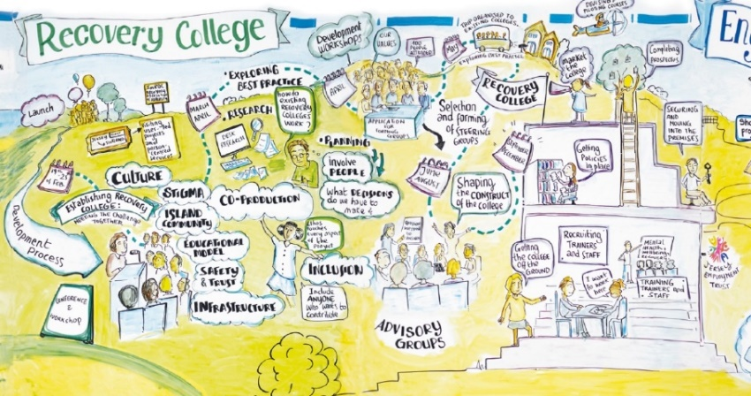
How does CoFoR exemplify integrated community care?
In the very beginning, we started from scratch. Everything had to be done outside of the mental health system. It was the occasion of being creative and of doing a real co-construction involving a majority of users. Absolutely everything was discussed and voted.
The 11 week courses take place in a school. Here people are students.
More than 90% of people working and teaching in the CoFoR have personal experience of mental health problems.
Students register themselves to the courses of their choice. Facilitators and volunteers support involvement and co-construction of the courses.
Every student is invited to participate in governance and decision making processes regarding the training center, or in communication or events.
Page 3

Slide 4
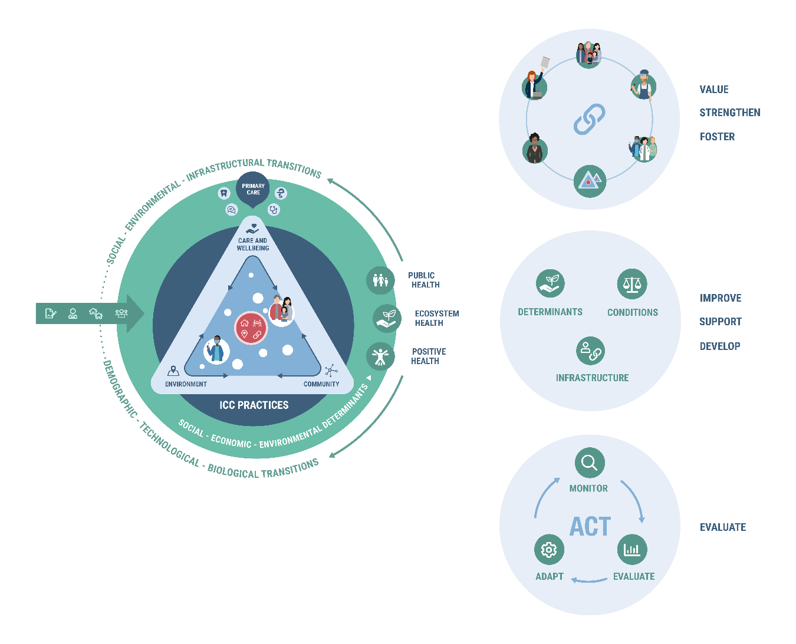
Implementation of the 7 ICC Effectiveness principles
The effectiveness principles[1] have been developed to guide action in a complex transition and turn Integrated Community Care from aspiration into reality. Each one is a clear and actionable statement that provides guidance for thinking and behaving toward some desired result. Building on the typology (introduced above) and the effectiveness principles, CoFoR is a practice that can be seen as embodiment of Integrated Community Care.
CoFoR exemplifies the effectiveness principles:
Co-develop health & wellbeing and enable participation:
The COFOR training modules are created by and for experts of personal experience. These experts are COFOR students but can also be facilitators.
COFOR strengthens community-oriented primary care through the collaboration with the health and social sector. Local alliances with associations, especially peer-support groups are a key aspect of the community building.
COFOR is not a care structure, the empowerment of people allows them to be actors of their health and disrupts caregiver-patient relations. COFOR emphasizes the skills of the people living with psychiatric disorders (for example with the 5th module: “towards peer-aid professions).
[1] See TransForm Strategy Paper
Page 4

Slide 5
Implementation of the 7 ICC Effectiveness principles cont’d
Building resilient communities through:
The approach is to allow individuals to preserve their health learning to live with their mental disorders. This includes, for instance, modules on risk reduction, on human rights, or on the Hearing Voices Movement.
COFOR joins people affected by mental disorders, caregivers and social workers together to cooperate with shared goals.
Since September 2019, COFOR has notably trained 200 professionals in recovery-oriented psychiatric practices.
COFOR does not intervene in the development of legal and financial conditions on the macro level, but only on the micro level. The training provided contributes to a self-help and co-participatory approach, in particular the module on human rights. A financial reward is given to each student who completes their course.
Monitor, evaluate & adapt
COFOR performs evaluation on several levels:
End of term evaluation by students: written and oral evaluation, which gives their opinion on the modules and the facilitation team. This evaluation is taken into account to continuously readjust the training modules
Sociodemographic data on students
Quantitative evaluations that analyse the impact of COFOR on stigma, self-stigma, well-being, empowerment and recovery
Qualitative evaluations carried out by a sociologist through individual interviews
Integration of COFOR in the national evaluation of the Ministry of Health on health autonomy (end expected in 2021).
Page 5

Slide 6
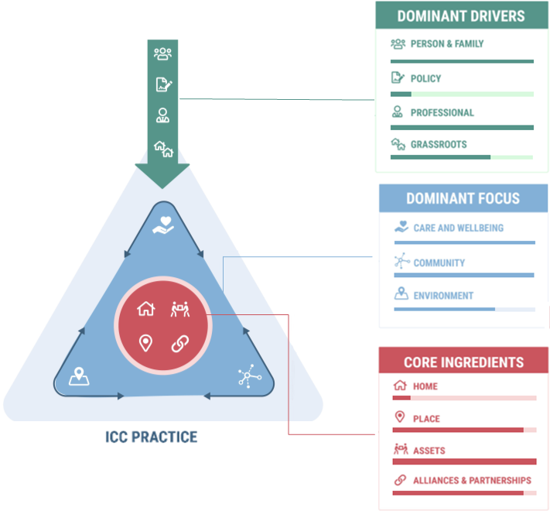
Typology
The TransForm project developed three main dimensions (drivers, focus and ingredients) that characterise the ICC practices. The assessment of these dimensions is visualised in a slider model. The slider bars illustrate how the various practices of ICC can be positioned on these core dimensions.
Page 6

Slide 7
Funding
Funding is provided by the DGS (Directorate General of Health) and Fondation de France.
Governance & Management
Partners are:
a local NGO of users and family of users (Solidarité Rehabilitation)
a school of social work: (IRTS)
a research center: (EA3279 in Aix-Marseille University)
a public hospital: (AP-HM)
The governance of the training is transparent and democratic, with strong involvement of students in the Management Committee that meets weekly, where all decisions are made.
Outcomes & Impact
CoFoR is the first Recovery College in France, whose modules are created by and for people living with psychiatric disorders.
Quantitatively, significant decreases have emerged in levels of auto-stigmatization (ISMI10 scale), and an increase in recovery scores (RAS scale) and well-being scores between the beginning and the end of the courses.
Qualitatively, the journeys of students are impressive, with lots of energy regaining hope and empowering themselves.
We think the structuring of a user-led recovery movement in France may be emerging, with CoFoR as the model.
Page 7

Slide 8
Lessons learned & Insights
Co-construction is longer and more demanding than other ways to perform a project, it is both a means and a goal.
Anger can arise in empowerment processes. Recovery is a perfect approach to know when anger is legitimate and when it is not.
A new module is beginning at the request of students: a professionalizing one about peer-work and professions in the self-help area.
Mental health activists in France are working to implement the CoFoR in other cities, like in Lille or in Paris.
Covid-19 Impact
The crisis clarified and validated the position of COFOR and the direction it should take. Individual student follow-up was discarded as an option because the entire team does not have peer-support skills. Instead, COFOR undertook the role of training center. Students needing support were directed to peer-aid platforms or associations providing peer support, such as the Lacdam association in Marseille. COFOR ensured a presence via social networks.
COFOR decided to set up distance training modules, These raised ethical questions: how to offer distance training while guaranteeing unconditional access? how not to exclude students without access to digital? The solution was to buy a dozen computers to equip students who did not have them. In June, the hybrid distance training modules “towards peer_aid professions” and “recovery” were launched. The Monday evening group meetings were also resumed with the hybrid method during this period. The meetings were greatly appreciated, both for their content and for the opportunity to renew social ties between students. The last term continued until the end of July (a setback from the end of the school year), and the students validated their course and received their financial reward. COFOR did not lose any students along the way. The students who could not attend modules during this period were postponed until September.
The IRTS center, host of the courses, reopened its doors at the beginning of September and was once again able to offer classrooms to COFOR. The five modules resume gradually, exclusively at school. This gradual reopening was a month behind the usual process. Early September, 60 students were on the waiting list to be contacted, to integrate these modules (a lot more than usual !).
Page 8

Slide 9
Covid-19 Impact cont’d
The collective meetings on Monday plan to be resumed face-to-face. COFOR does not wish to continue the modules remotely in the long term unless they can be mixed with other configurations. Although virtual working can certainly have positive aspects such as avoiding the displacement of those with phobias and inclusion of those hospitalized, but it also raises questions of confidentiality and/or security problems.
COFOR is based on a participatory methodology that is constantly changing and adapting. Containment and the crisis required an even more intense adaptation.
In addition, COFOR has been an established project for 3 years now. The known strengths, the place in the community , and the accepted role of COFOR, aided in choosing and validating COFOR’s position and actions during the crisis.
The bonds of solidarity are already an integral part of the functioning of COFOR. The crisis nonetheless reinforced this solidarity between students. For example, a student spontaneously proposed the creation of a musical group which still endures and which has extended to patients of a medical-psychological center.
To allow these links to be integrated in a more sustainable way within healthcare practices, COFOR has created a new training module which is offered to students who are people affected by psychiatric disorders and to medical students (3rd year of psychiatry internship). This module makes it possible to take into account the words/voice of experts by experience and to change how future psychiatrists view their patients. Another joint module is designed for people with psychiatric disorders and nursing students.
Further resources & Contacts
In addition, Cofor is part of the Recovery Colleges community, as are:
The Recovery College of Boutabika (Uganda)
The Formazione ed Opportunita per la Recovery in Lombardy (Italy)
The British Network to inform and support the creation of Recovery Colleges
The Dorset Recovery Education Center (UK)
The Solent recovery center Solent Recovery College (Portsmouth, United Kingdom)
The Sussex Recovery College (UK)
The Mind Recovery College (Australia).
Severn & Wye Recovery College (Gloucester, United Kingdom)
And many others…
CoFoR contact:
http://www.coforetablissement.fr/index.php/contact/
celine.engel@solidarite-rehabilitation.org jul.grard@gmail.com
aurelie.tinland@gmail.com
Page 9

